Slide 1
75
Discrete Mathematics
Equivalence Relations

Slide 2

















Slide 3

















Slide 4










Slide 5


































Slide 6
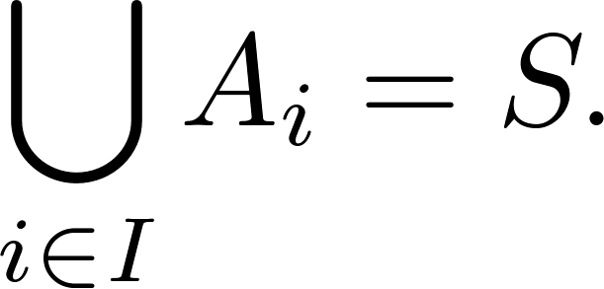

















Slide 7






Slide 8









Slide 9
Up Next…
Introduction to Graphs

